Slide 1
INFORMATION TO THE FACILITATOR – KEEP HIDDEN!
This slide deck is our standard facilitation deck for Playmakers®.
Use this as a starting point for developing your own slides. No two workshops (or two facilitators) are the same.
The deck is divided into five parts, pick and chose which ones serve your purpose and your own comfort level as facilitator.
As a general rule, use as few step-by-step slides as possible as they tend to make the game experience rigid.
The five parts:
Sample agendas: Sample scripts matching the facilitator’s guide.
Introducing the game: Introduction to the basic elements and concepts of the game.
Step-by-step facilitation guide: Use this for larger workshops and in the beginning when you are learning the game yourself.
Example reflections: Sample exercises to help you reflect.
Theories and background: Supplementary theory and background material. These can be used before, after or during the game depending on the agenda.

Slide 2

PLAYMAKERS®
Leading teams to high performance
® © Workz A/S 2018 – www.workz.dk

Slide 3
SAMPLE AGENDA

Slide 4

FULL-DAY PROGRAMME
09.00 Introductions and welcome
09.30 Starting the game
10.30 Break
10.45 Phase 1 – Pre-study
12.30 Lunch
13.15 Phase 2 – Design
14.15 Phase 3 – Implementation
15.15 Break
15.30 Back to reality
16.15 Wrap-up
16.30 End of day

Slide 5
INTRODUCTION TO THE GAME

Slide 6
PLAYMAKERS® IN A NUTSHELL
Training performance oriented
team leadership and stakeholder engagement in project management

Slide 7

YOUR PERSONAL BOOKLET
You have each been given a personal Booklet
Please write your name on it
We are now ready to start the game!

Slide 8
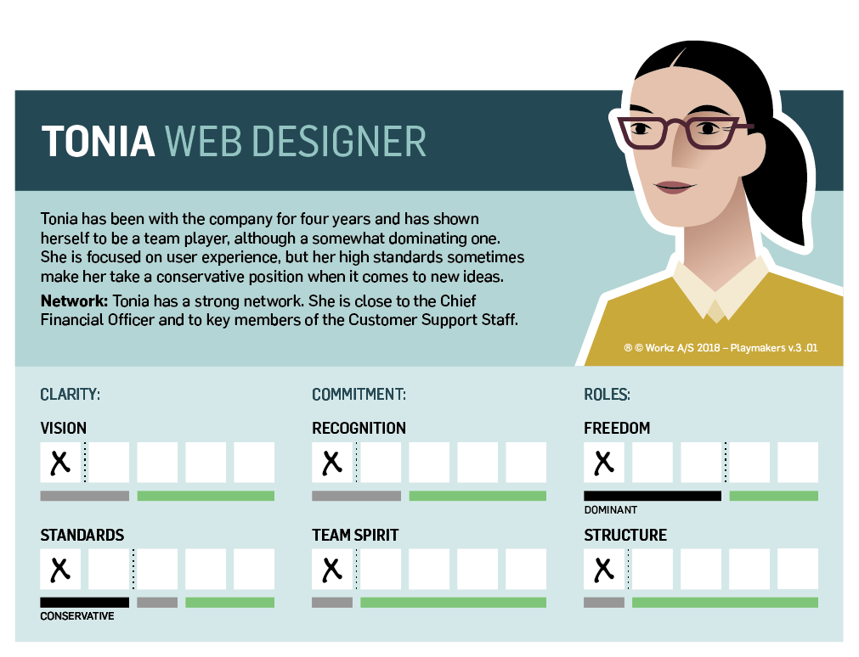
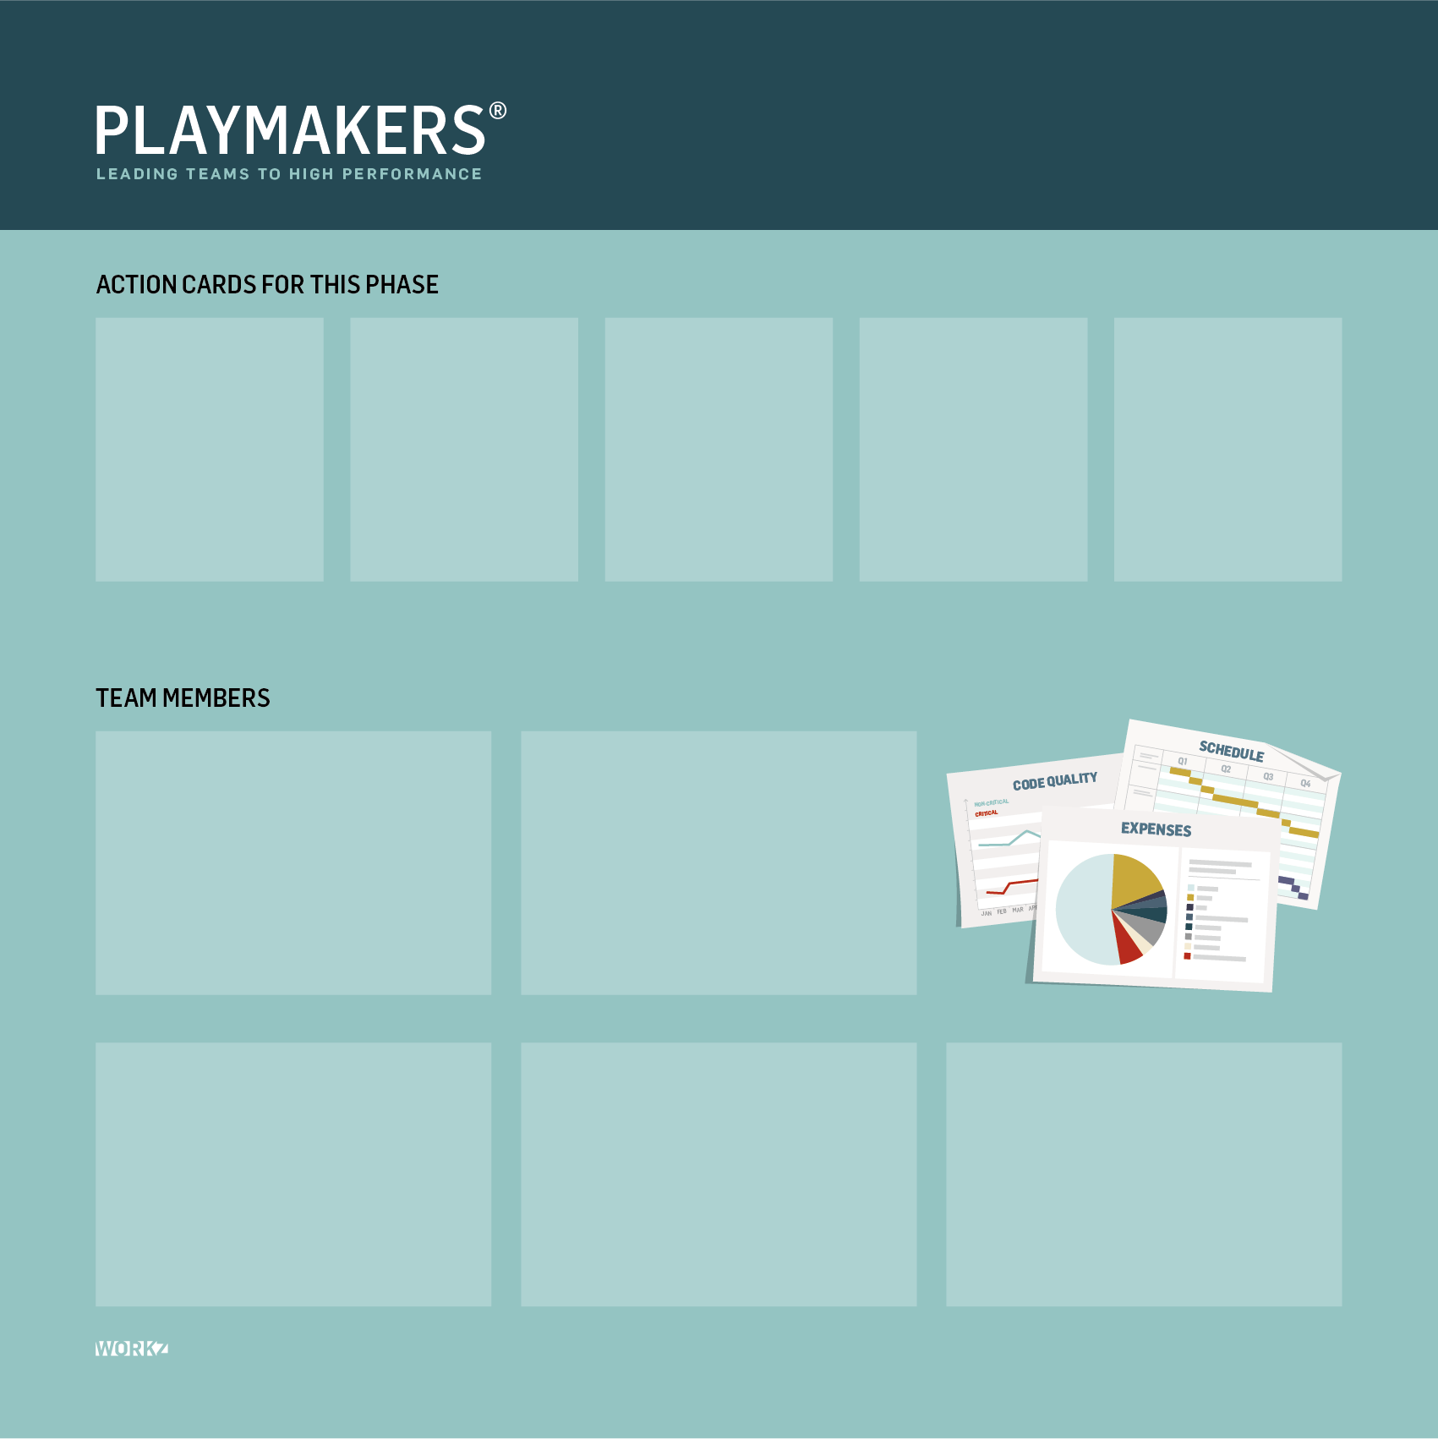
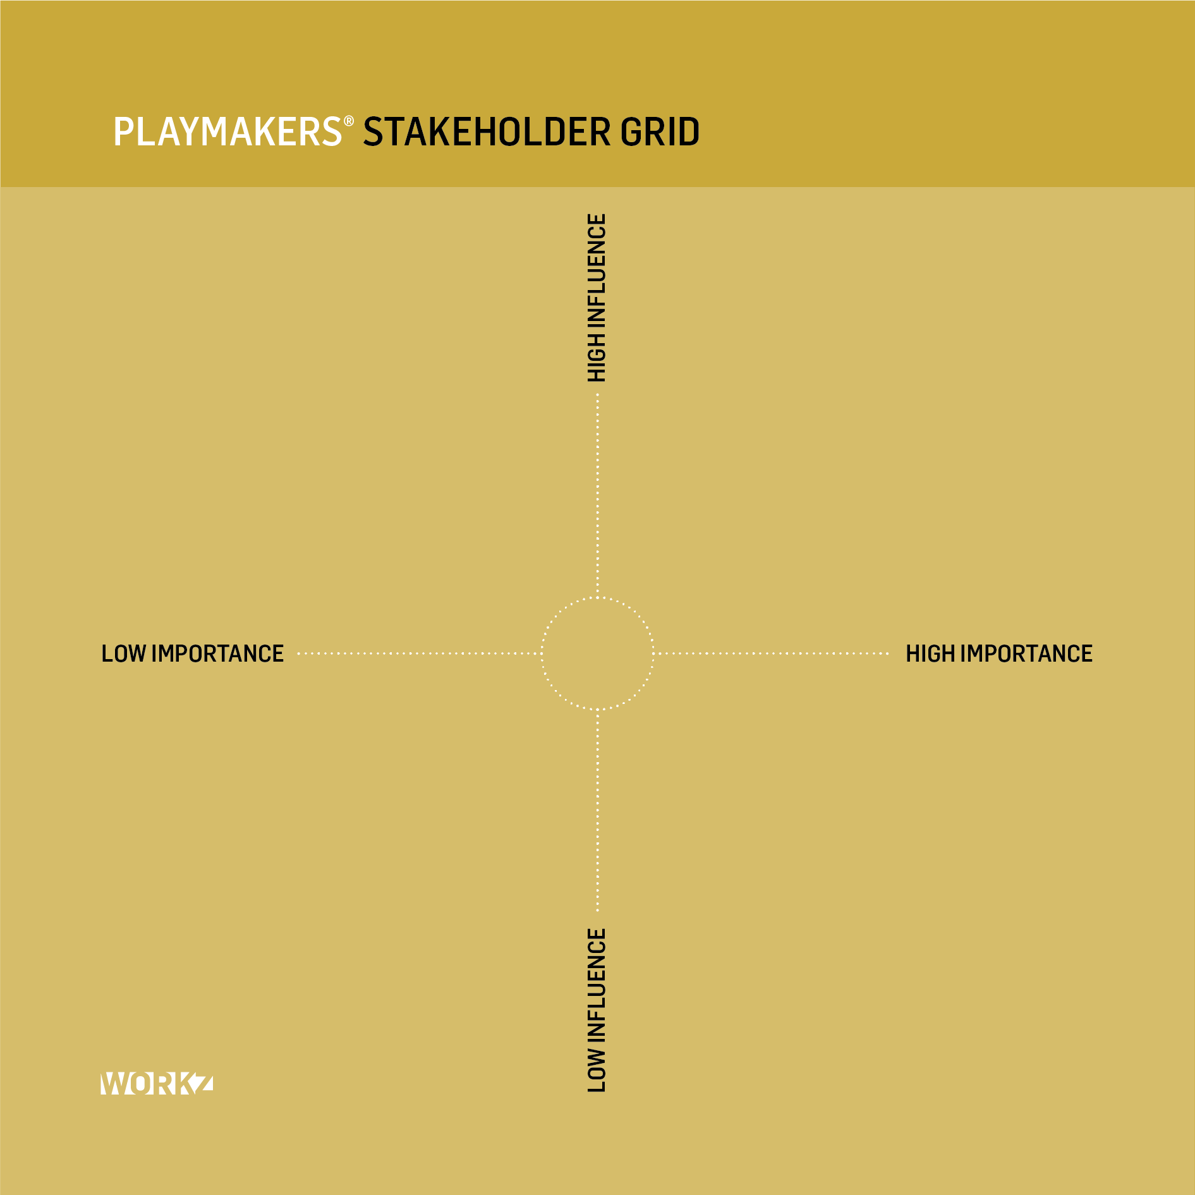
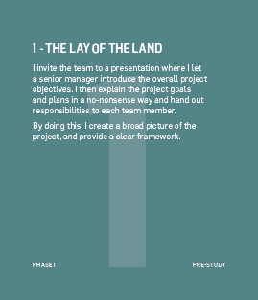
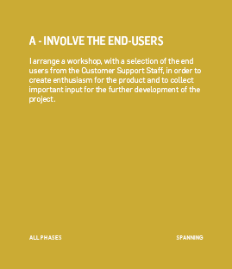
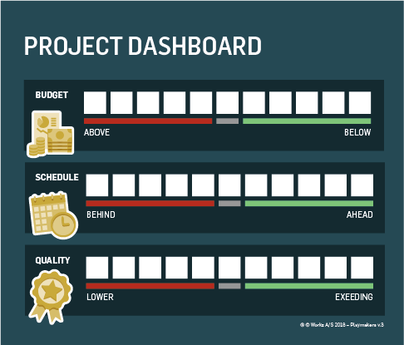
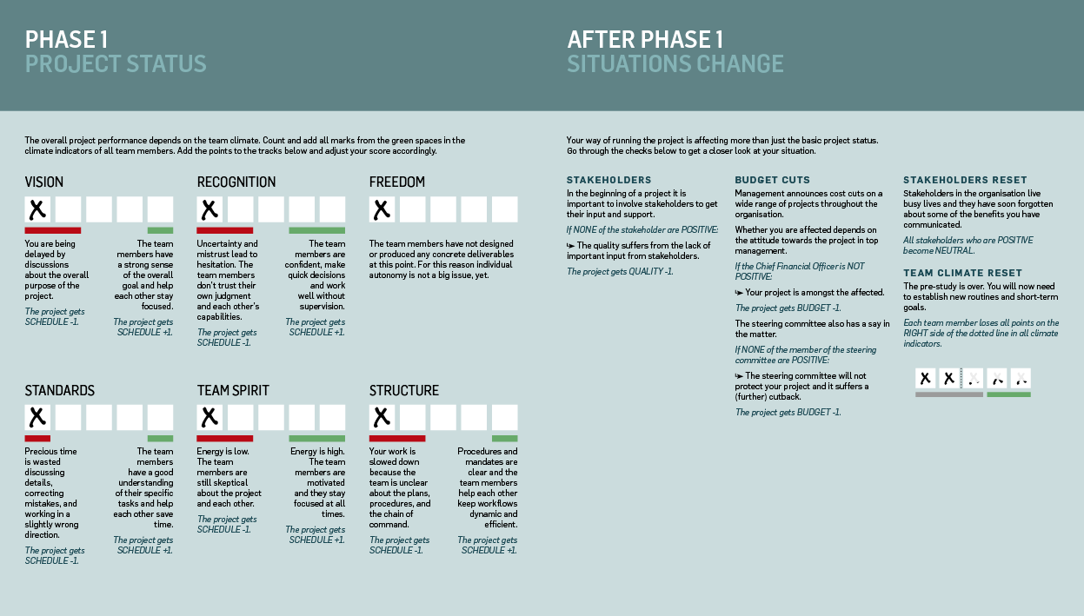
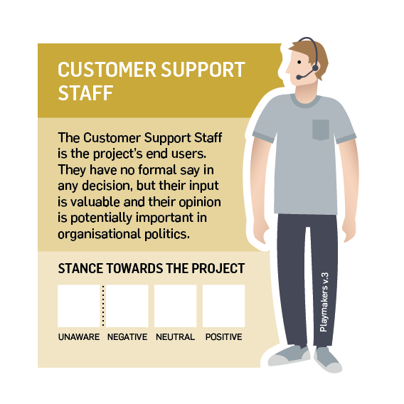
Elements of playmakers
Team Member
Round Specific Action Cards
Stakeholder Analysis
Spanning Action Cards
Project Status
Dash Board
Game Board
Stakeholder

Slide 9
STEP-BY-STEP FACILITATION GUIDE

Slide 10

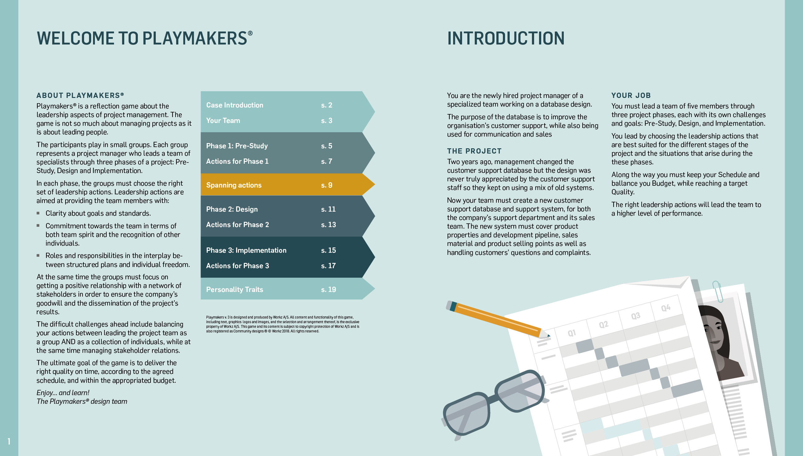
THE CASE
Read pages 1-2
You are the newly hired project manager of a team working on a database design
Your team consists of 5 specialists
You also have a number of stakeholders who will be important at various points in the project
Your job is to build a well-performing team that delivers the database on time, on the agreed budget and with the right quality

Slide 11
STAKEHOLDERS

Slide 12
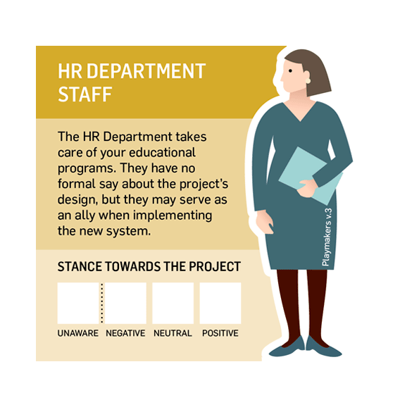
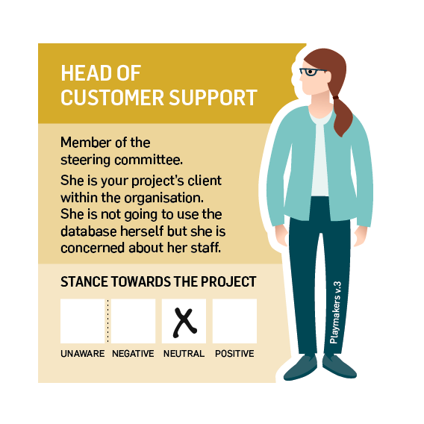
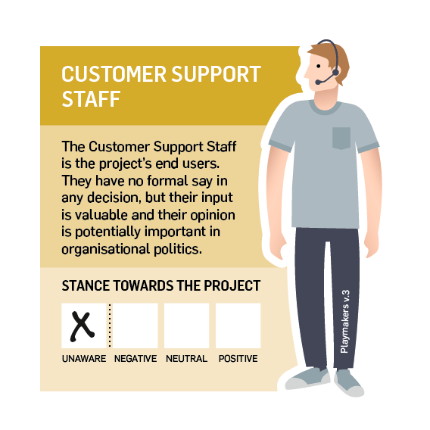
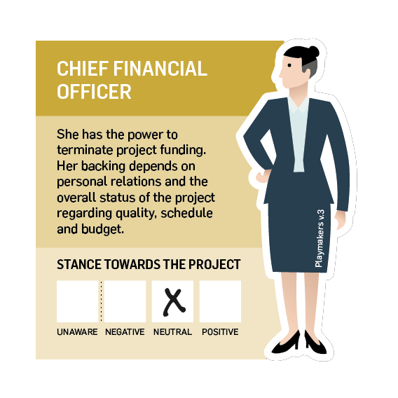
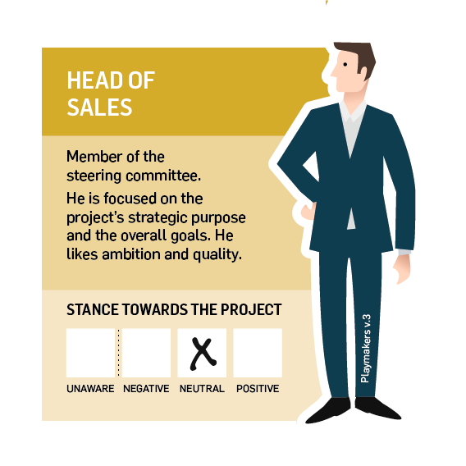
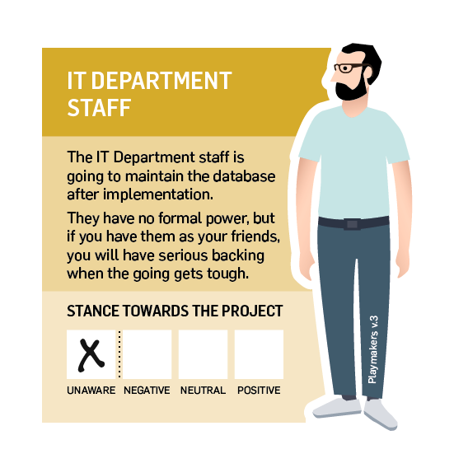
THE STAKEHOLDERS’ STARTING ATTITUDE
CFO, Head of Sales and Head of Customer Support is “Neutral”
All other stakeholders are “Unaware”
Mark the stakeholders’ attitudes on their cards

Slide 13
Team members
Background, personality, needs and network
Climate indicator
Active personality trait
Synergy

Slide 14
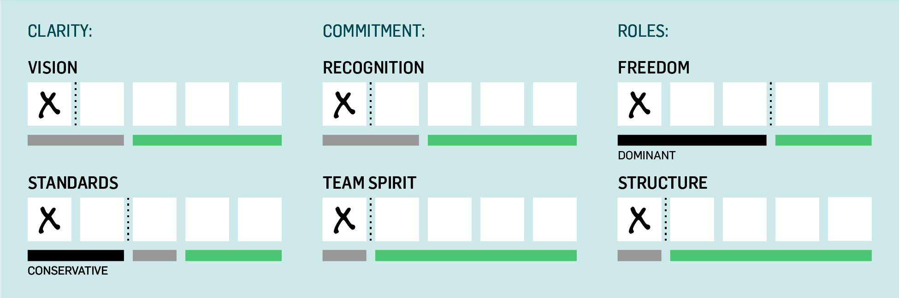
climate indicators
There are six climate indicators:
Understanding the purpose of the project. Why are we doing it?
Feeling recognised as a person. Does my work matter?
Being empowered and able to make decisions. Am I free to work the way I prefer?
Understanding and respecting the quality standard for the project. Is this good enough?
Feeling connected to the team and trusting the other team members. Am I alone in this?
Knowing the schedule and the chain of command. What are the procedures?

Slide 15
CHOOSE YOUR TEAM
Read
the team members
Read all 10 potential team members
Select 5 members:
  2 Software Engineers
  1 Designer
  1 Consultant
  1 Project Assistant
Reflect on your team
“Are there any team members who will demand extra attention?”
“Are there any personalities that might clash in your team?

Slide 16
CHOOSE YOUR TEAM
Read
the team members
You have been assigned Tonia (Designer), Jacques (Software Engineer) and Gina (Project Assistant).
Select 2 more team members
  1 Software Engineer
  1 Consultant
Reflect on your team
“Are there any team members who will demand extra attention?”
“Are there any personalities that might clash in your team?

Slide 17
MEET YOUR TEAM
Read
the team members
You team consists of:
Tonia (Designer)
Jacques (Software Engineer)
Kapil (Software Engineer)
Helmuth (Consultant)
Gina (Project Assistant)
Reflect on your team
“Are there any team members who will demand extra attention?”
“Are there any personalities that might clash in your team?

Slide 18

PHASE 1 –
Pre-study

Slide 19
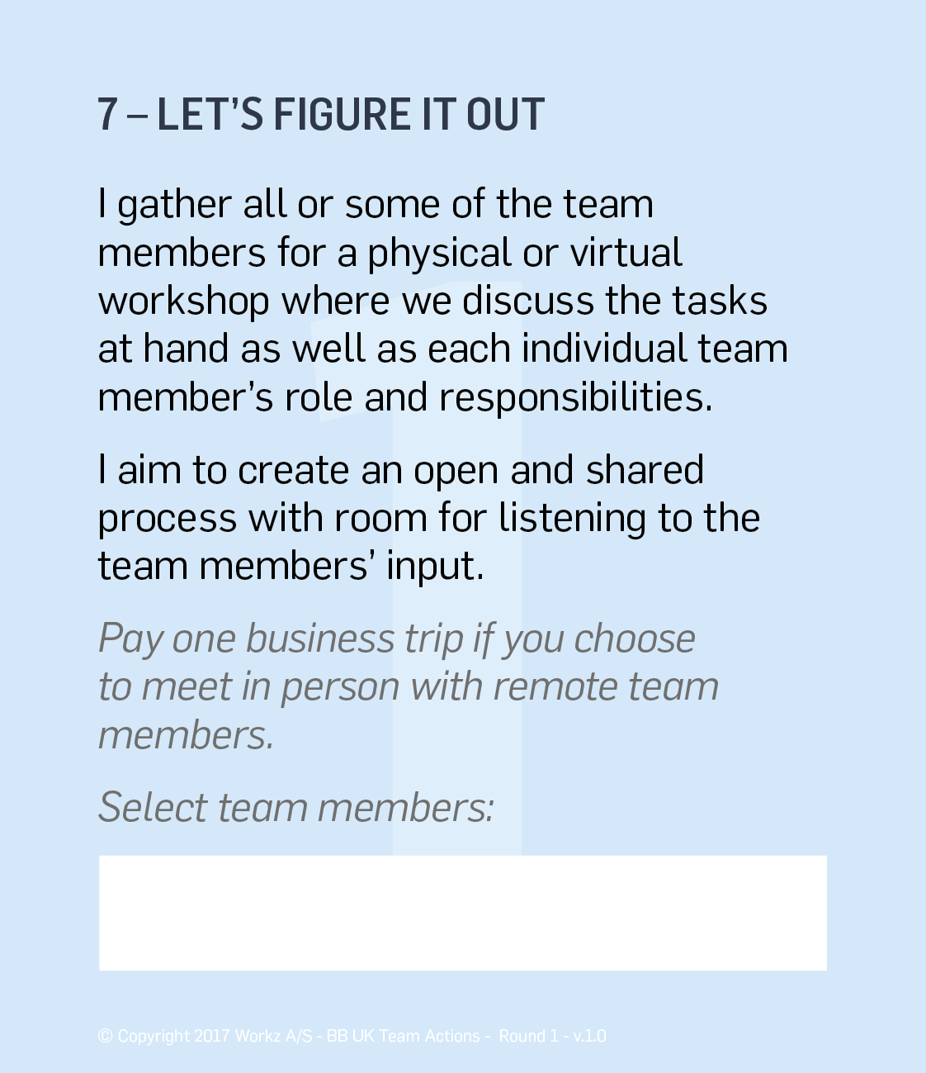
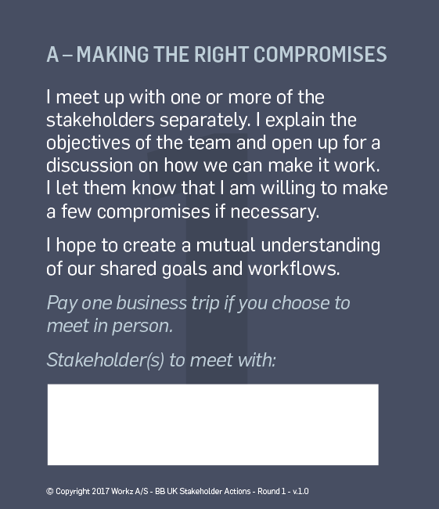
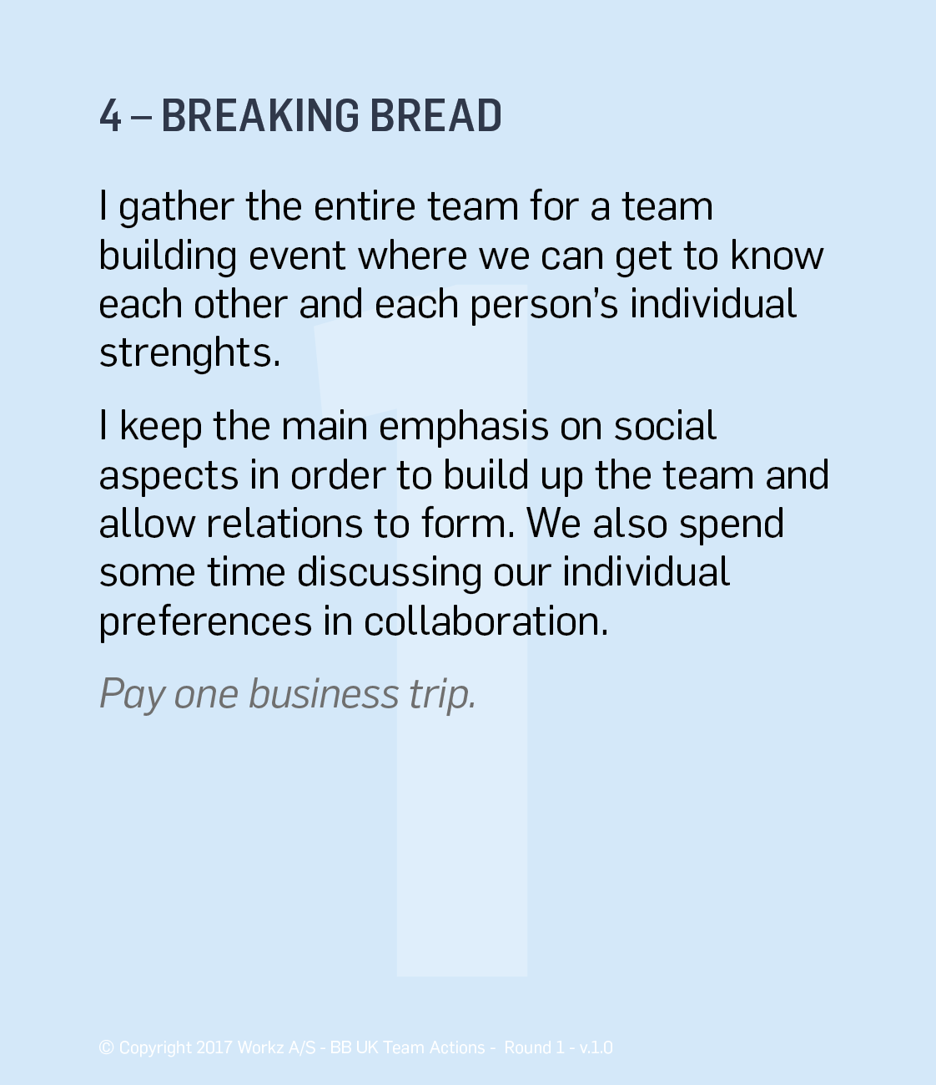
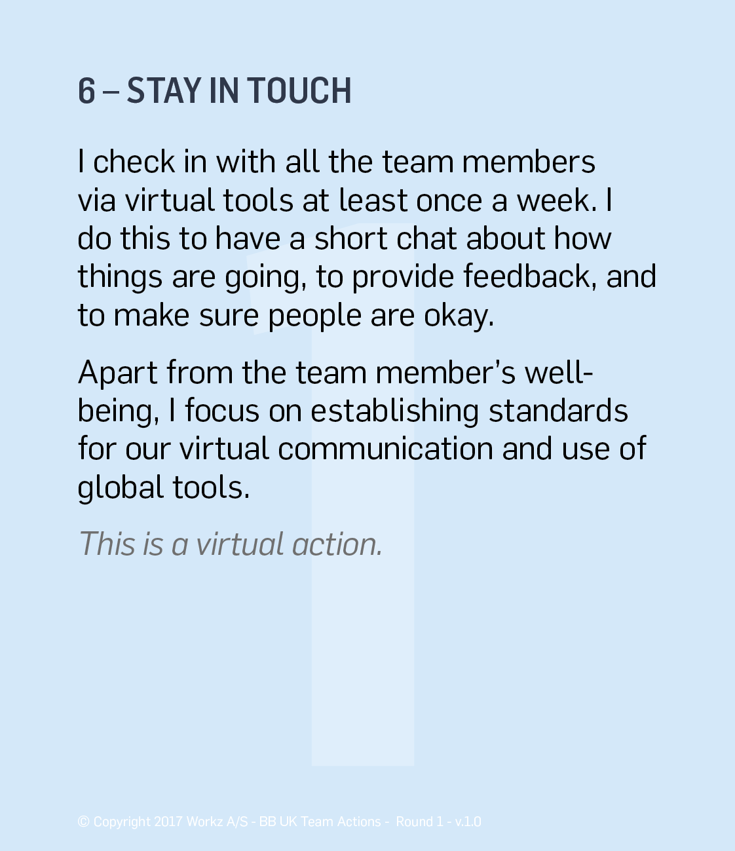
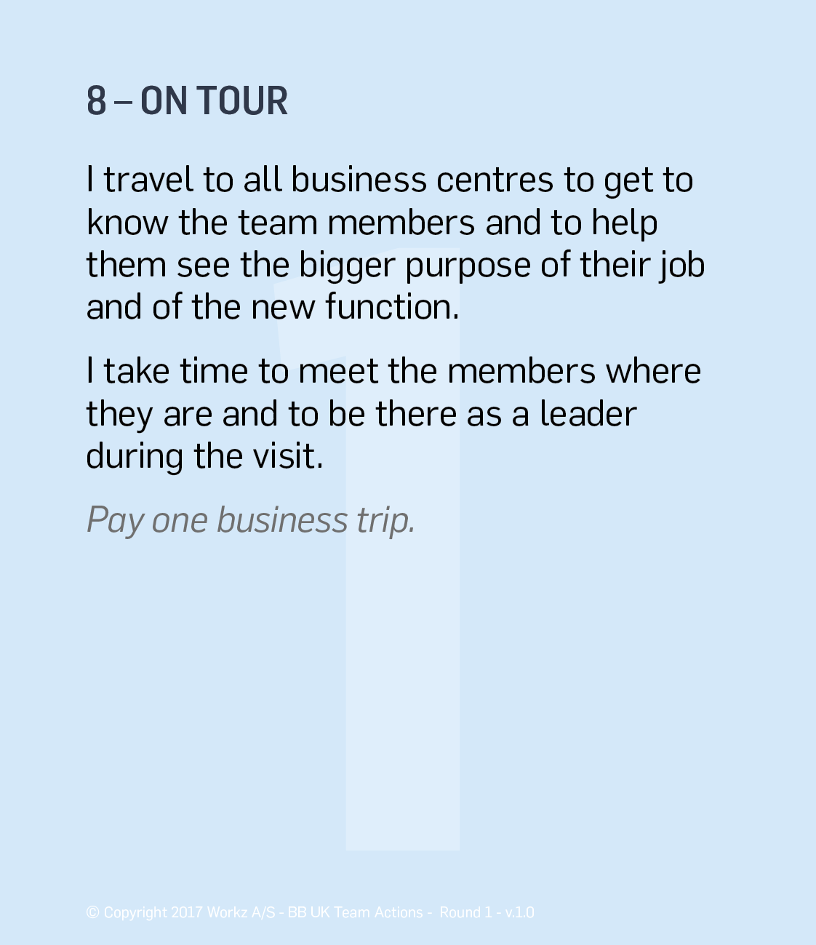
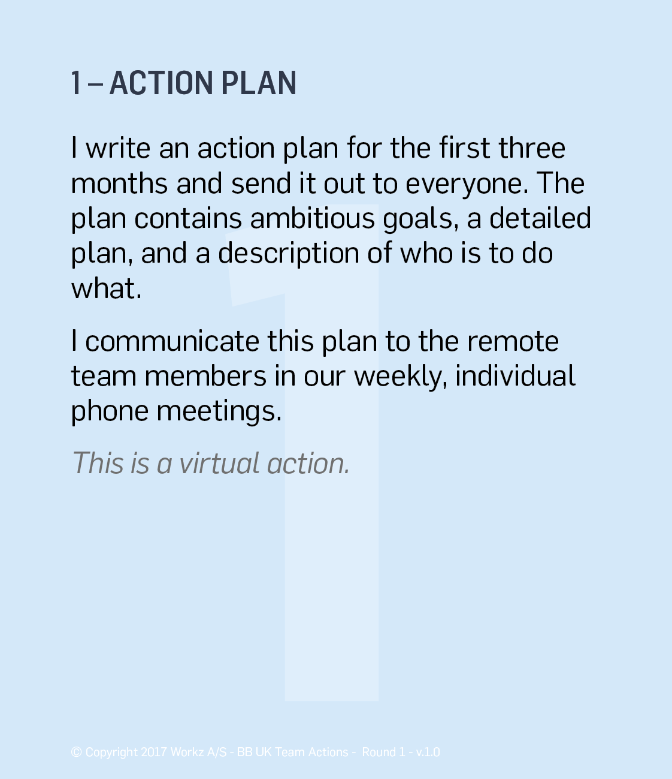
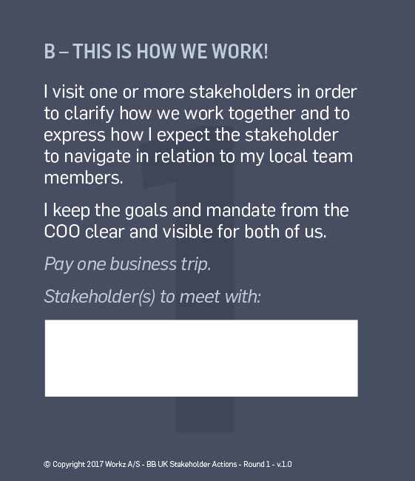
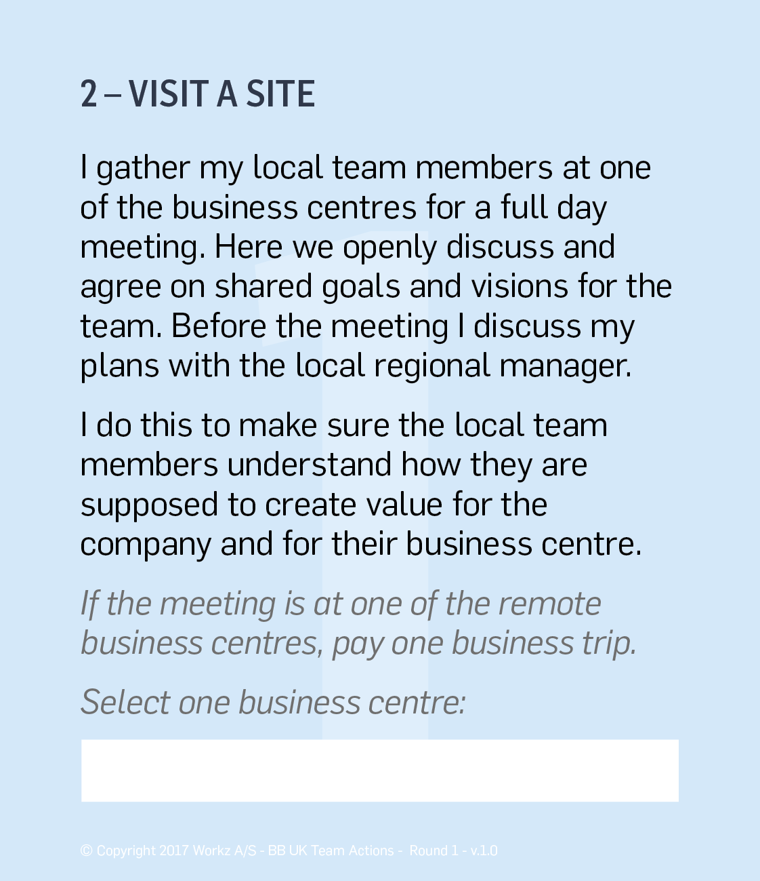
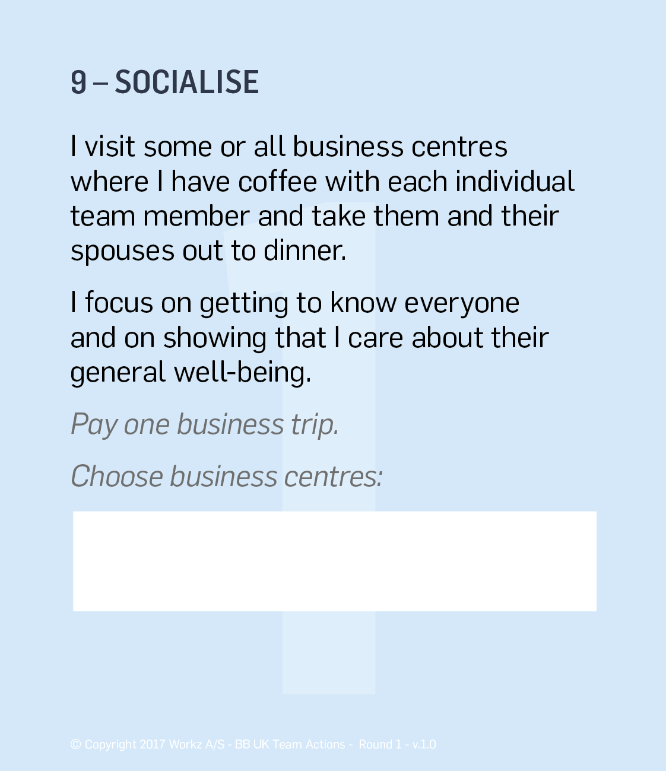
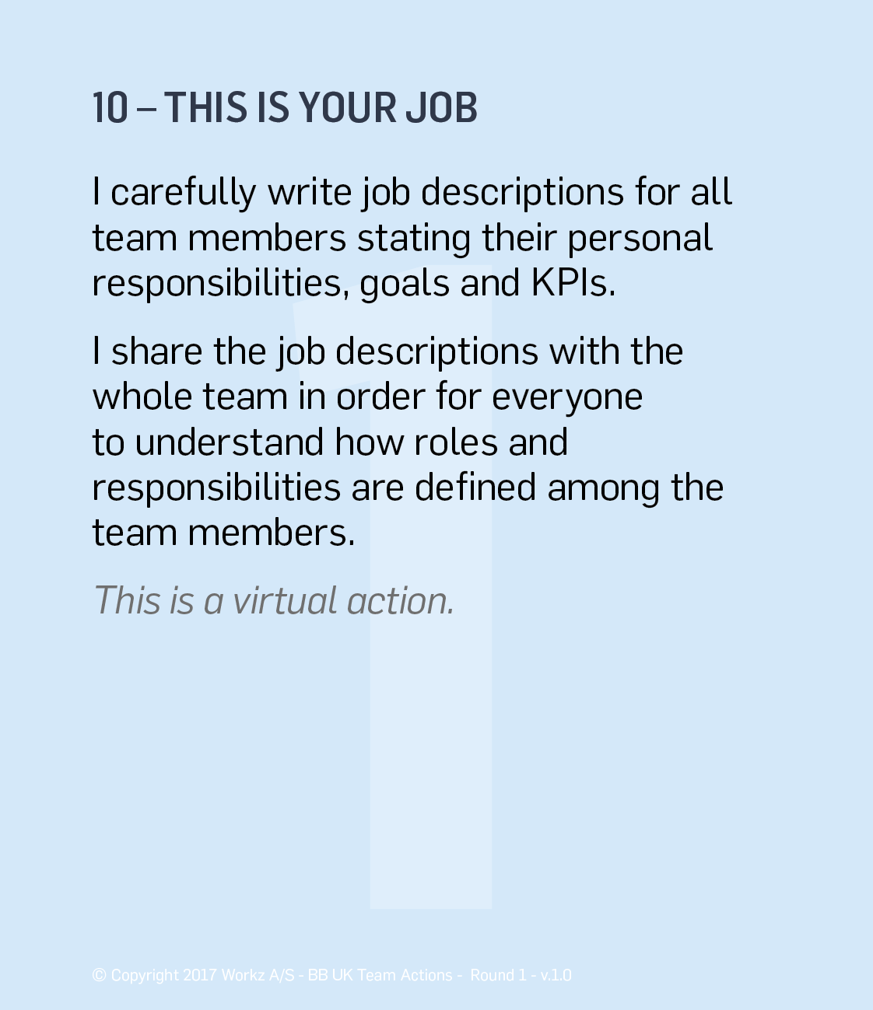
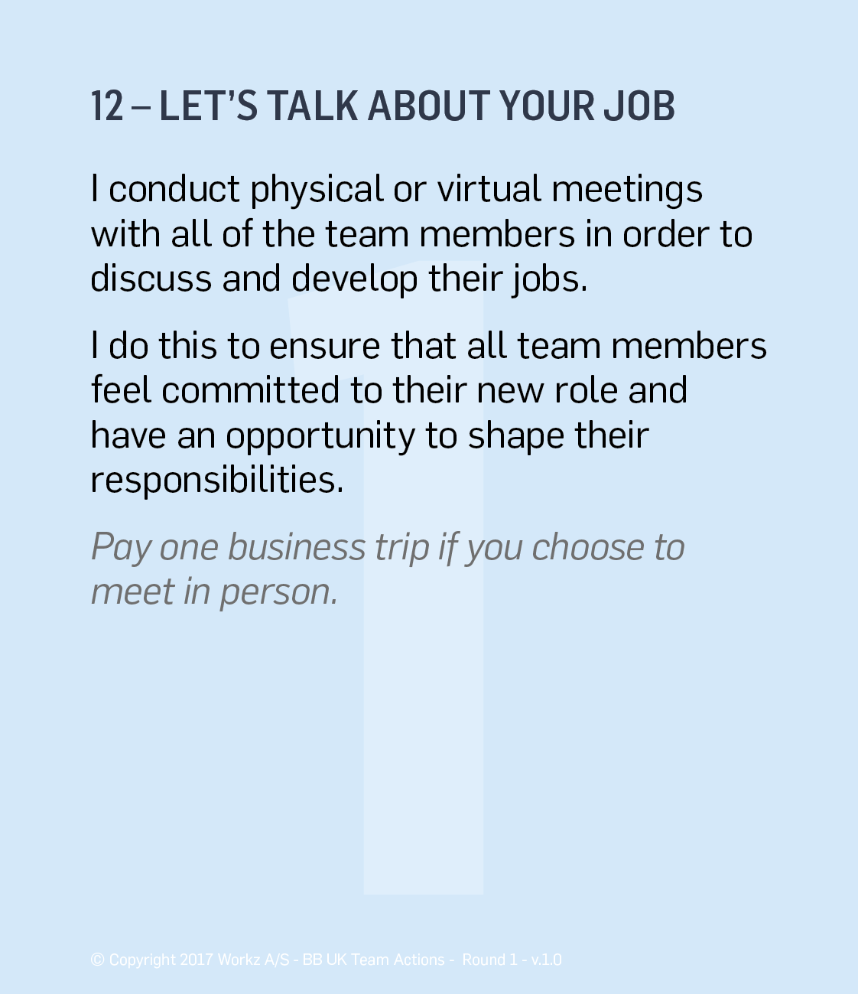
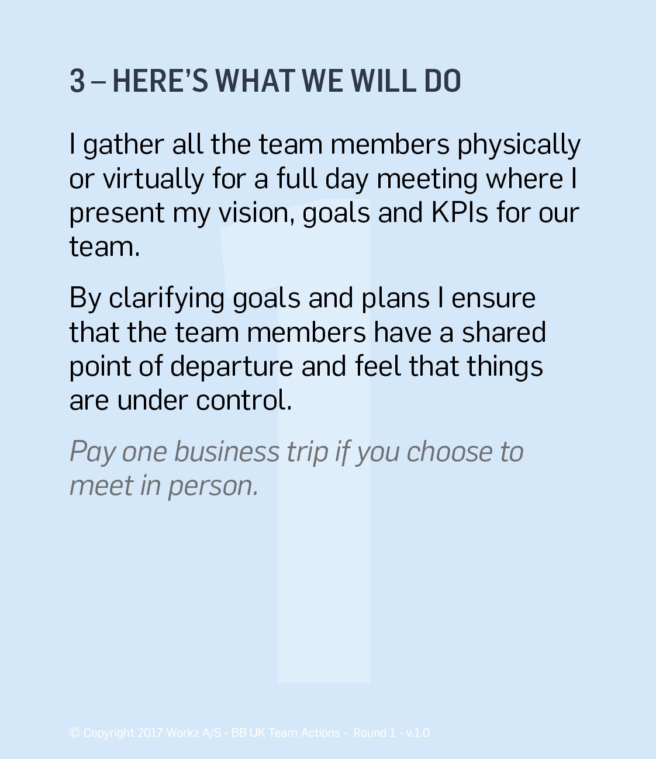
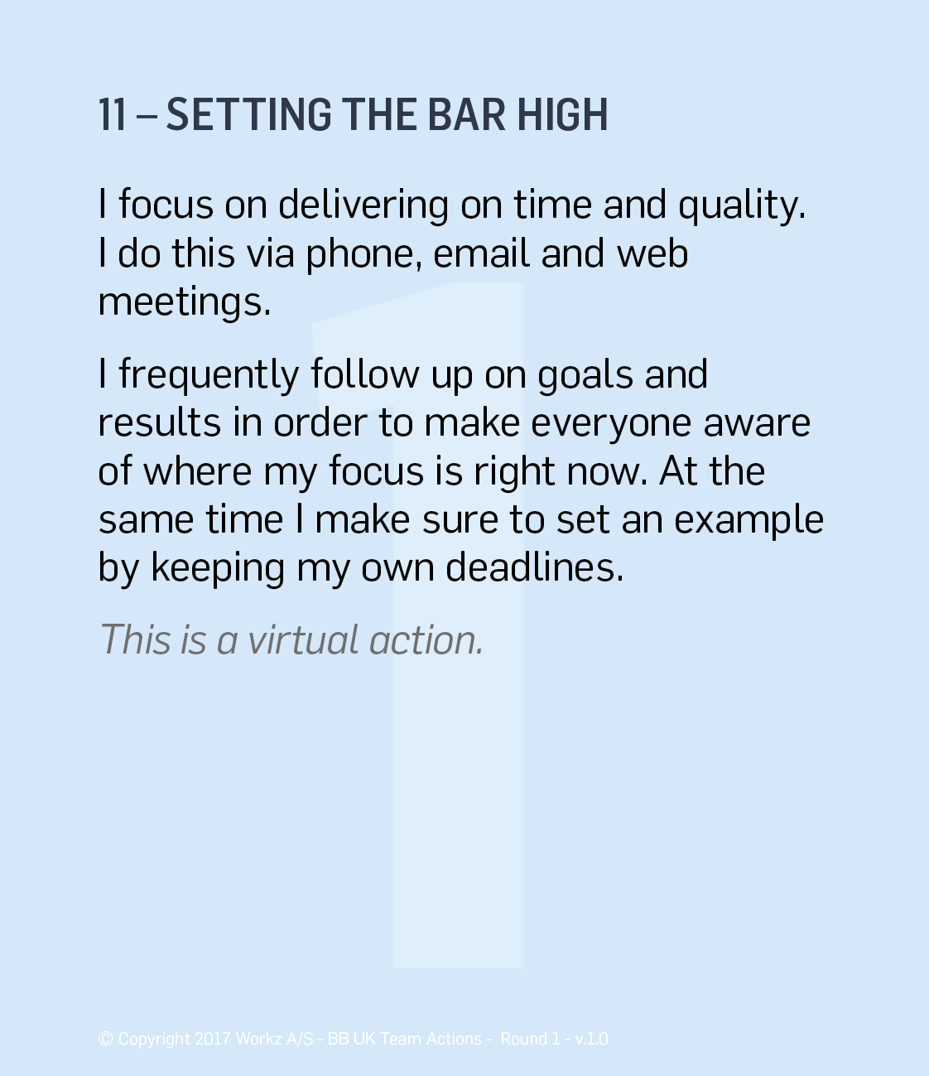
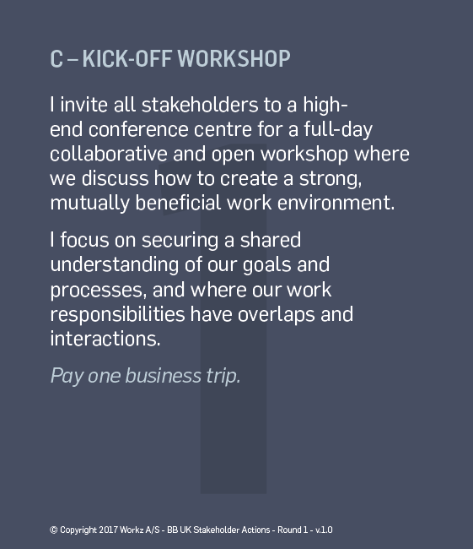
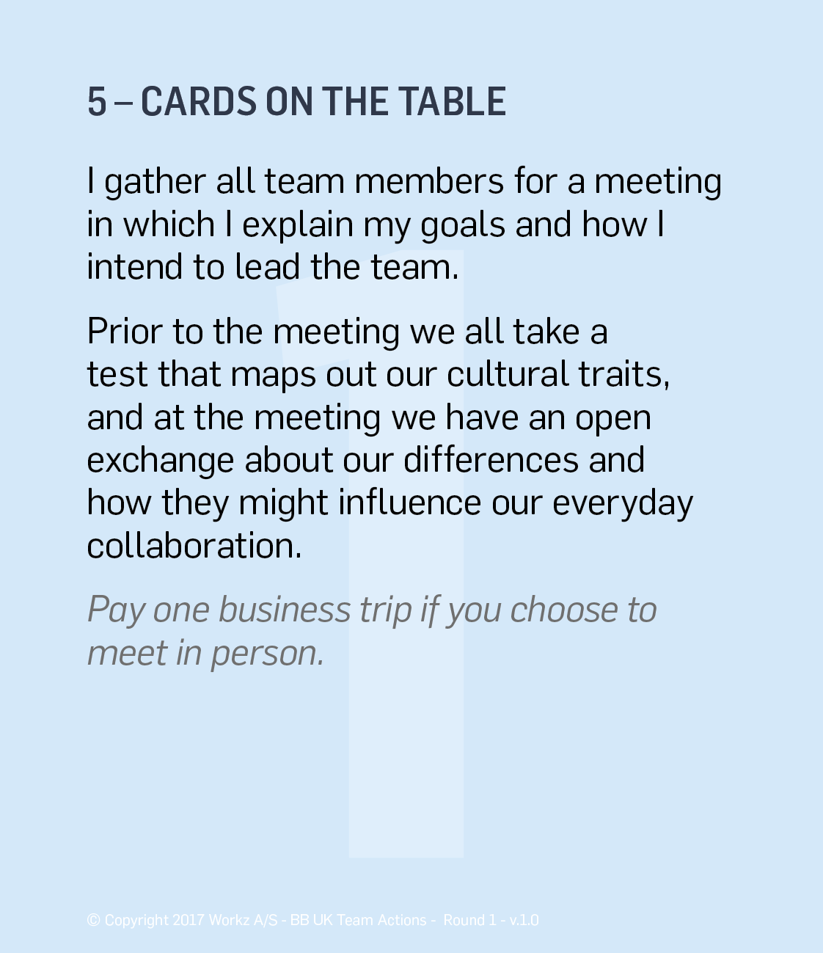
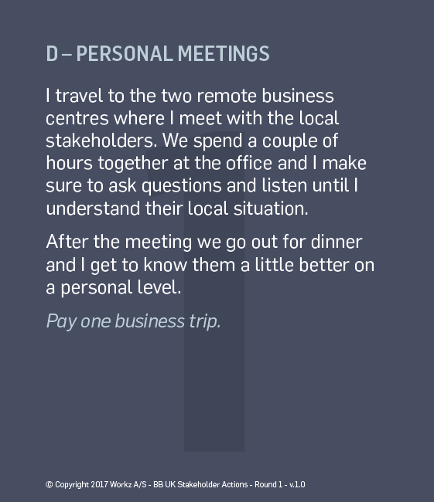
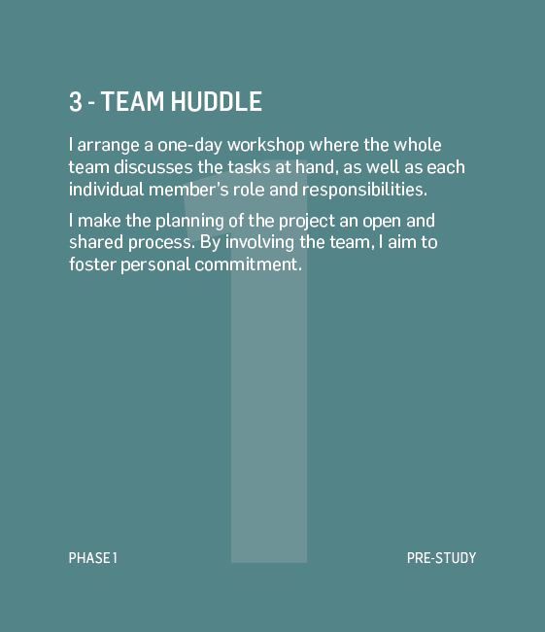
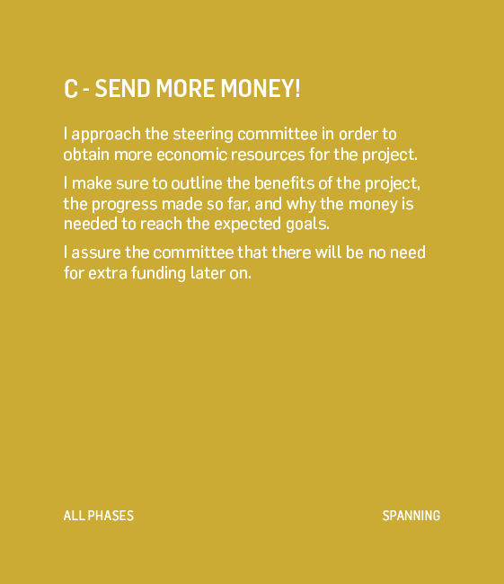
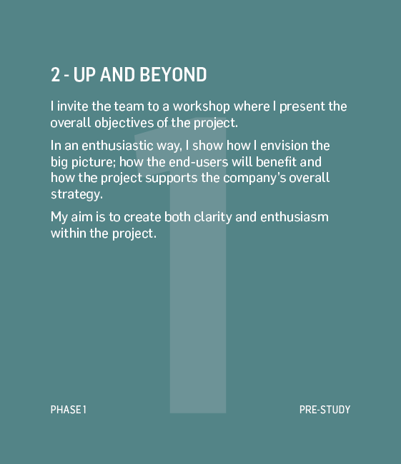
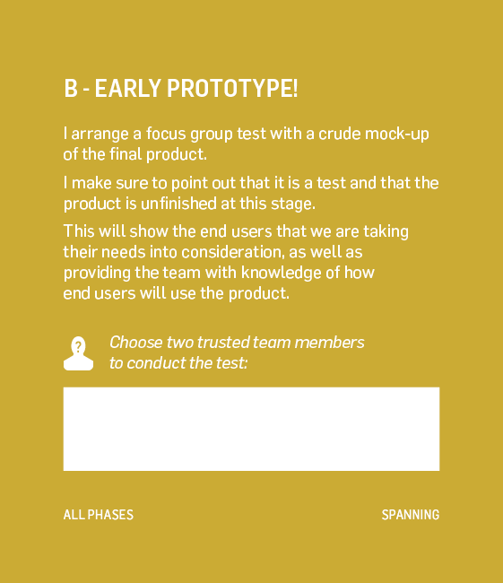
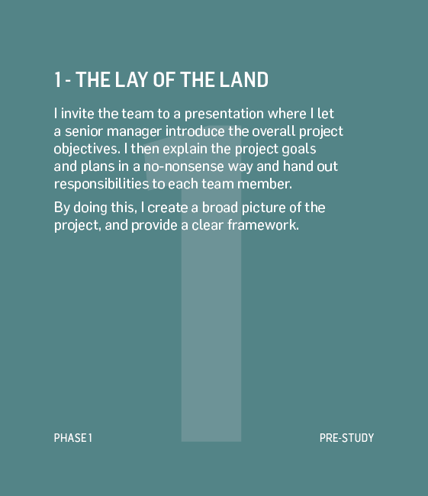
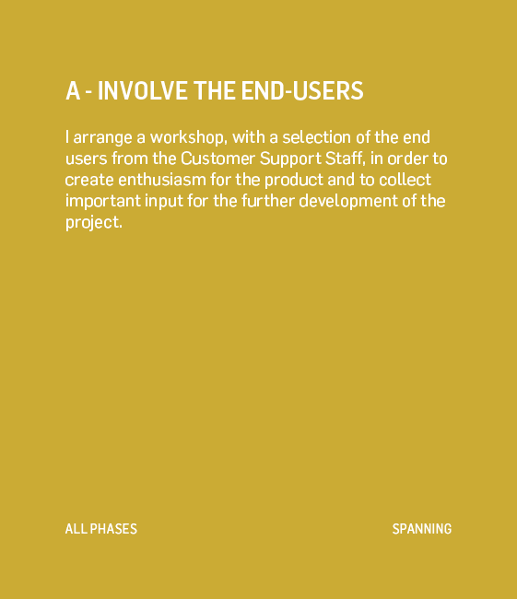
LEADERSHIP ACTIONS IN THE GAME
Each phase, you select five actions
They can be any combination of Phase Specific and Spanning actions

Slide 20
YOUR MISSION
Page
3
Please read you mission and discuss your task as it relates to your team and stakeholders
“What do you want to change with your team members?”
“What do you want to do with the stakeholders?”

Slide 21




MAKE A PLAN
Pages
4-7
Select your 5 leadership actions and the sequence in which to carry them out
First read them individually, then agree on a plan together

Slide 22
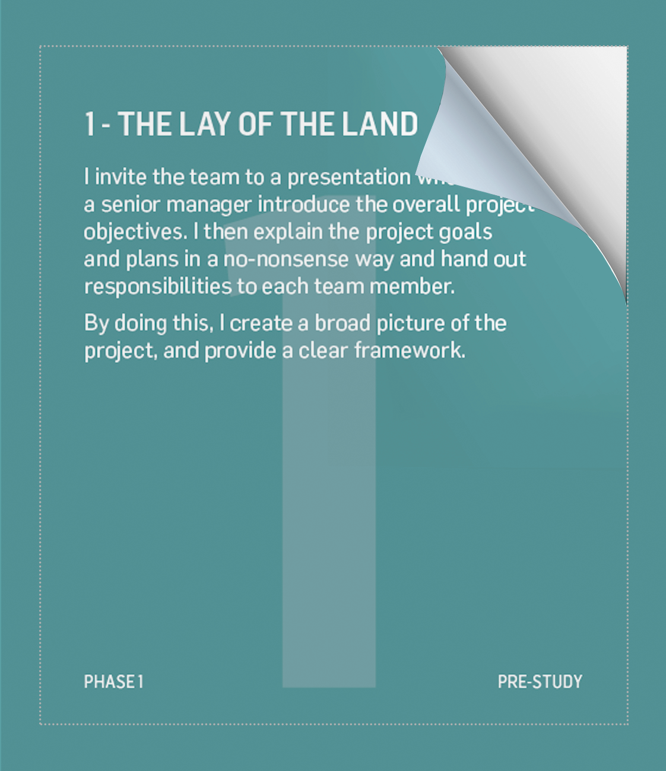
EXECUTE YOUR PLAN
Now open your actions one at a time and read
what happens
Apply the changes to the team members and stakeholders
You may change your plan and select new actions
if needed
Note: Once a card has been opened, it can not
be undone!

Slide 23
RESULTS OF PHASE 1
How well did you do?
Read the check sheet and apply the changes to the dashboard
What else happens?
Read and apply any changes

Slide 24
REFLECTIONS
Discuss your plan and the results of your actions
“Why did you choose the cards you did? What worked well? What did not go as planned?”
“What results did you get? And why?
“Which was your most inspiring dialogue?”

Slide 25

PHASE 2 –
DESIGN

Slide 26
YOUR MISSION
Page
8
Please read you mission and discuss your task as it relates to your team and stakeholders
“What do you want to change with your team members?”
“What do you want to do with the stakeholders?”

Slide 27


MAKE A PLAN
Pages
10-11
Select your 5 leadership actions and the sequence in which to carry them out
First read them individually, then agree on a plan together
Remember: You can still use the spanning (orange) actions you have not yet used

Slide 28
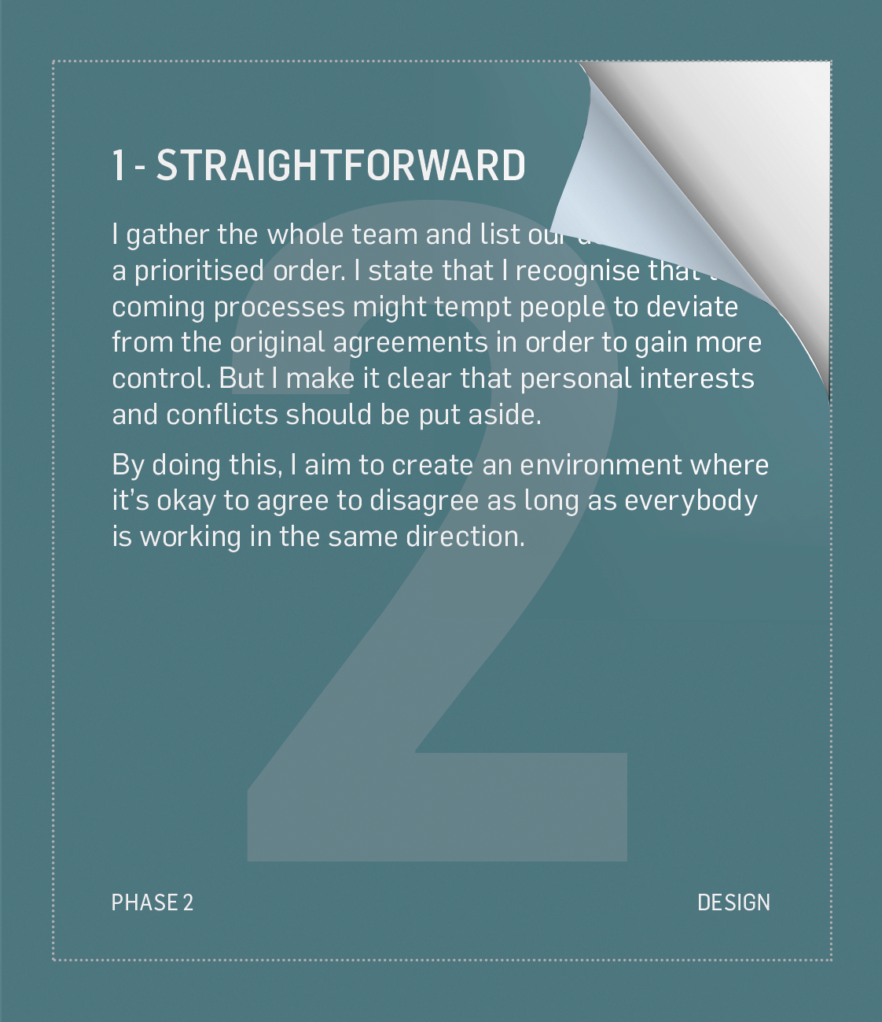
EXECUTE YOUR PLAN
Now open your actions one at a time and read
what happens
Apply the changes to the team members and stakeholders
You may change your plan and select new actions
if needed
Note: Once a card has been opened, it can not
be undone!

Slide 29
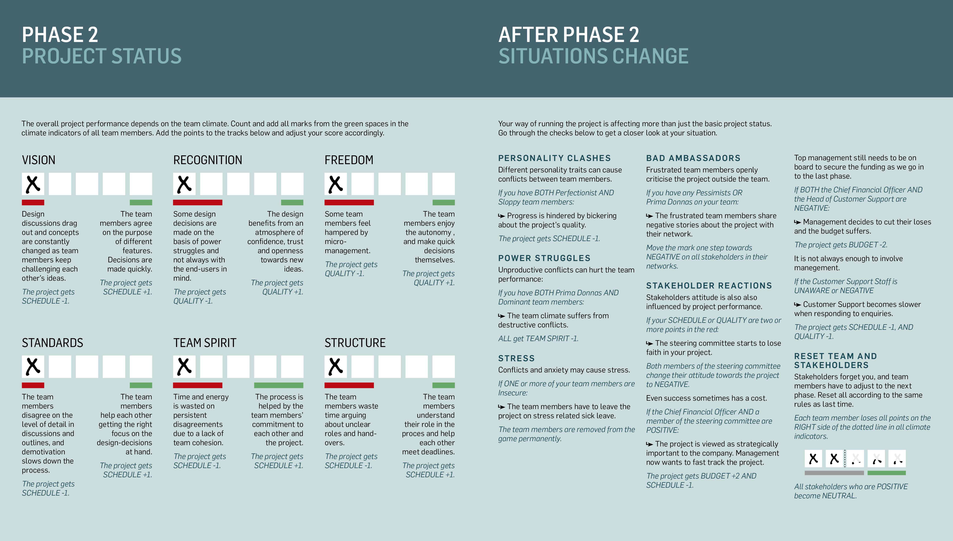
RESULTS OF PHASE 2
How well did you do?
Read the check sheet and apply the changes to the dashboard
What else happens?
Read and apply any changes

Slide 30
REFLECTIONS
Discuss your plan and the results of your actions
“What do you recognise from your daily work as project managers?”
“What approach would work the best in your organisation?”
“What would you do differently in real life?”

Slide 31

PHASE 3 –
implementation

Slide 32
YOUR MISSION
Page
12
Please read you mission and discuss your task as it relates to your team and stakeholders
“What do you want to change with your team members?”
“What do you want to do with the stakeholders?”

Slide 33


MAKE A PLAN
Pages
14-15
Select your 5 leadership actions and the sequence in which to carry them out
First read them individually, then agree on a plan together
Remember: You can still use the spanning (orange) actions you have not yet used

Slide 34
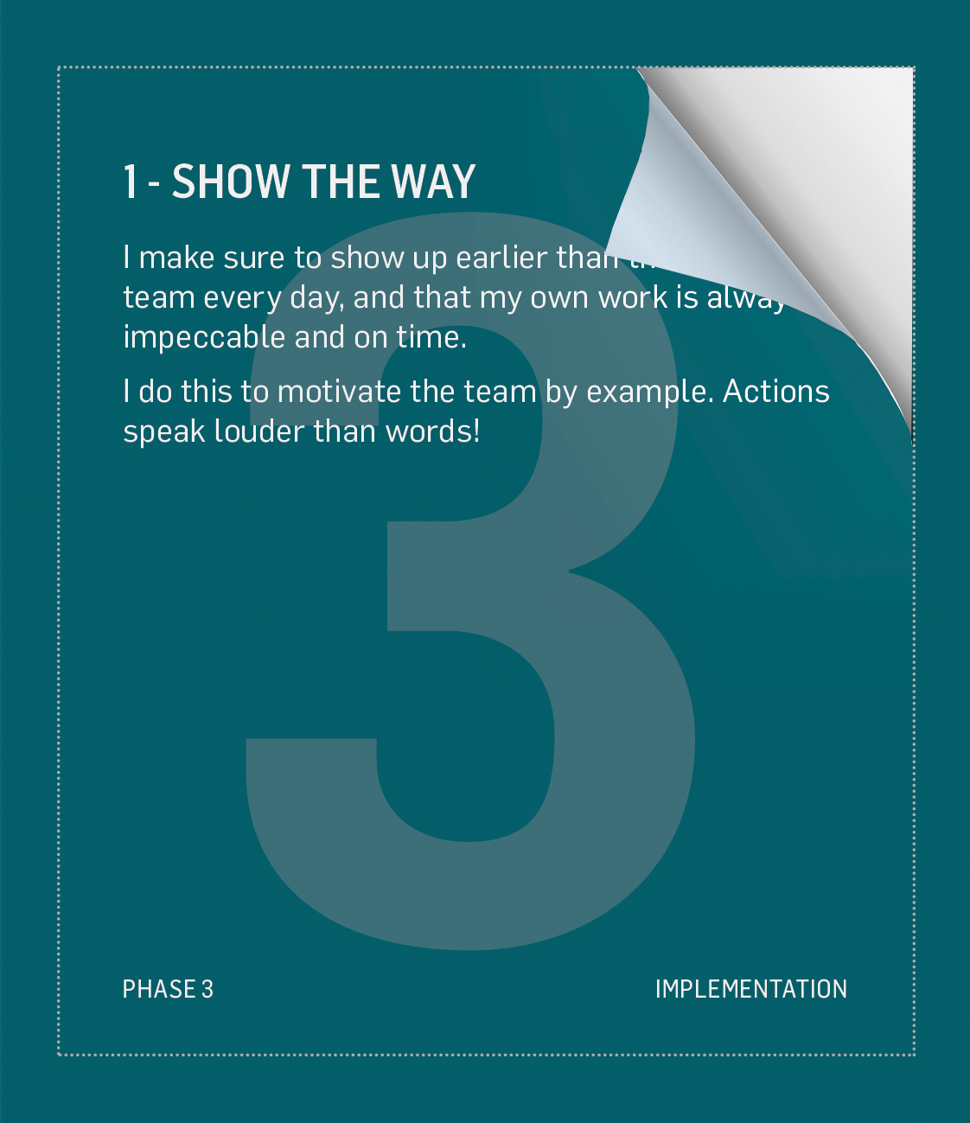
EXECUTE YOUR PLAN
Now open your actions one at a time and read
what happens
Apply the changes to the team members and stakeholders
You may change your plan and select new actions
if needed.
Note: Once a card has been opened, it can not
be undone!

Slide 35
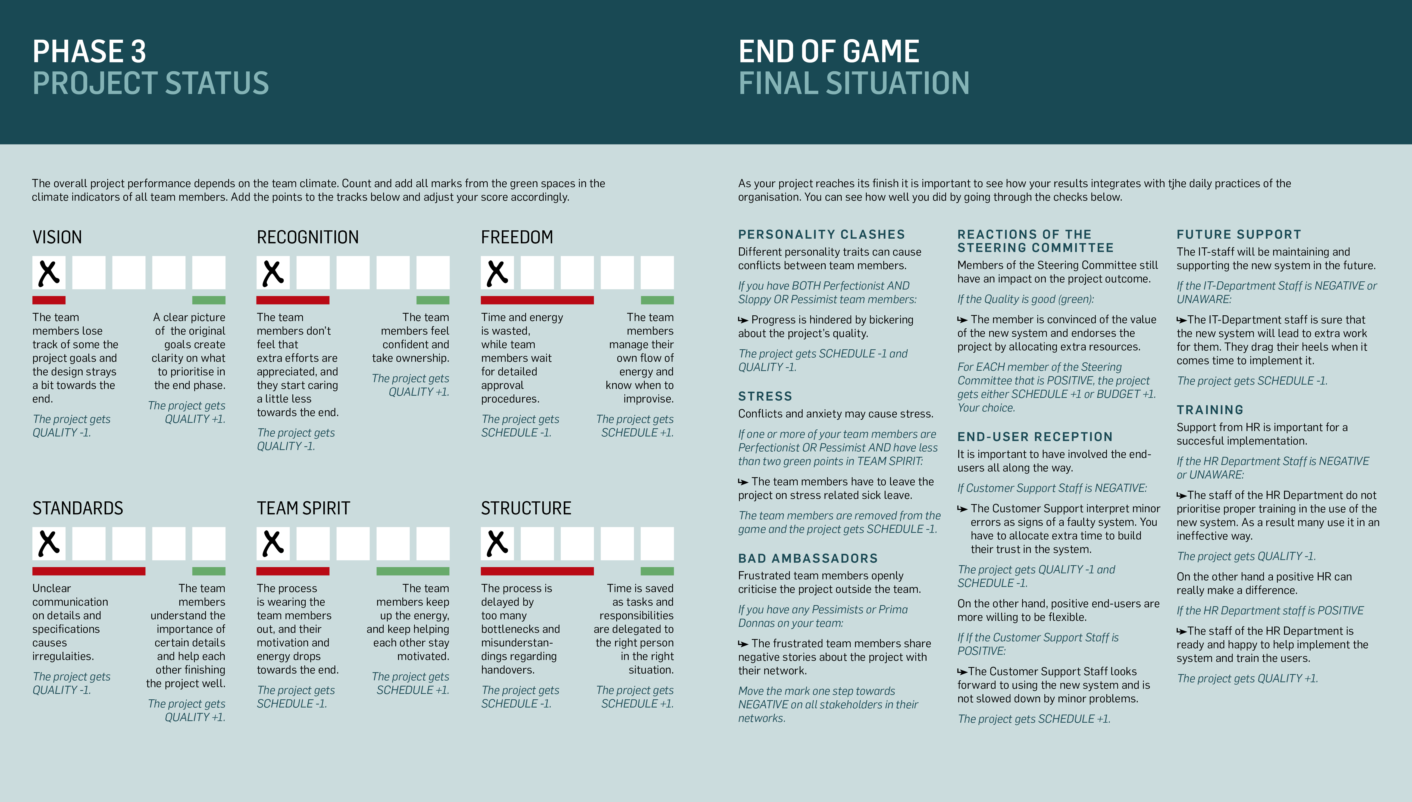
RESULTS OF PHASE 3
How well did you do?
Read the check sheet and apply the changes to the dashboard
What else happens?
Read and apply any changes

Slide 36
REFLECTIONS
Discuss the game and how it matches your experiences
“What leadership challenges did you experience in the game? What are your own experiences?”
“What kind of leadership worked well in the game? How does this match your experiences?"
“What have inspired you the most? Is there anything you want to do differently in the future?”

Slide 37
AFTER PHASE 3 –
EPILOGUE

Slide 38
REFLECTIONS
Discuss the game and how it matches your experiences
“Look at the scores for the different teams. Which project would be the golden standard in your organisation?”
“What is most important: Quality, Budget or Schedule?”

Slide 39
THE END

Slide 40
Example reflections

Slide 41
WARM-UP REFLECTION ABOUT TEAM LEADERSHIP
Individually, think about a positive experience of team leadership, either as a leader or as an observer.
Share within your group and capture key learnings.
Remember these points when playing Playmakers®!
“What were the key factors that made it a success?”
“What happened?”

Slide 42
REFLECTIONS ON CLIMATE INDICATORS
Discuss in the group the role of the three categories of climate indicators.
What is your one main conclusion from this phase on…
  The role of Clarity
  The role of Commitment
  The role of Roles
WRITE ON CARDSTOCK
ONE CONCLUSION PER CARD!

Slide 43
LEADERSHIP STYLES
Discuss in the group:
“What leadership styles have you used during this round of Playmakers?”
Would these styles work in your organisation? Why? Why not?

Slide 44
BACK TO REALITY
Individually consider this:
Based on your discussions today, consider these questions:
Share these action points with the person next to you and give each other feedback
“What are the first specific actions you can take when you come home?”
“Do you need help? And from whom?”

Slide 45
THEORIES AND BACKGROUND

Slide 46
JTI/MBTI PROFILES
ISTJ
ISFJ
INFJ
INTJ
ISTP
ISFP
INFP
INTP
ESTP
ESFP
ENFP
ENTP
ESTJ
ESFJ
ENFJ
ENTJ

Slide 47
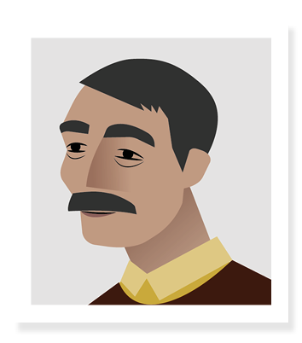


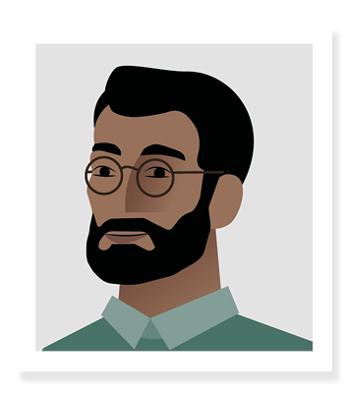
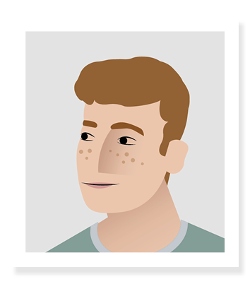
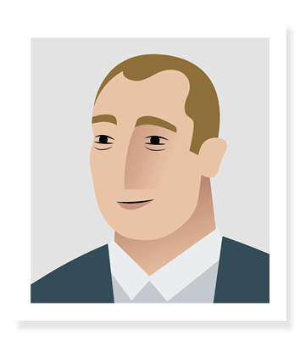



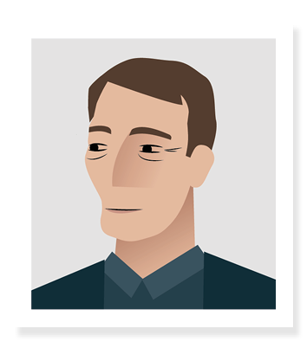
JTI/MBTI PROFILES FOR EACH MEMBER
ISTJ
ISFJ
INFJ
INTJ
Kapil
Clara
Sadia
ISTP
ISFP
INFP
INTP
Carlos
ESTP
ESFP
ENFP
ENTP
John
Helmut
Jaques
ESTJ
ESFJ
ENFJ
ENTJ
Gina
Tonia
Dieter

Slide 48
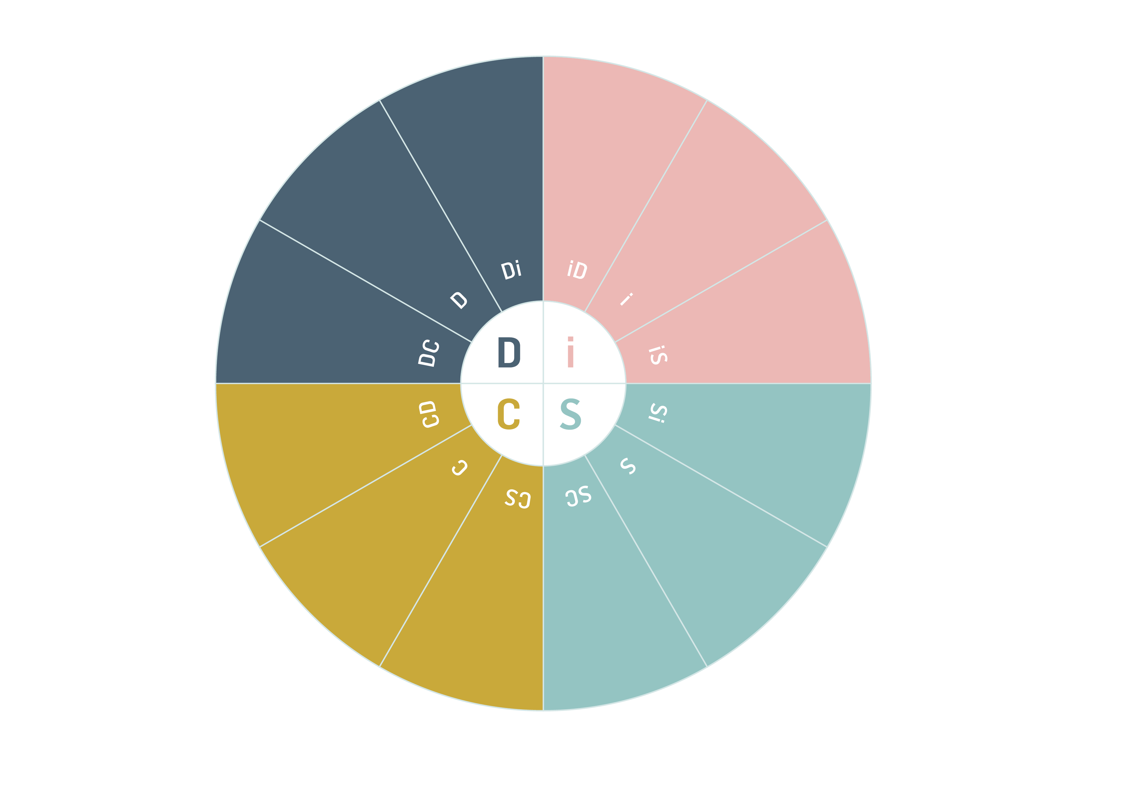
DISC

Slide 49
DISC WORKPLACE
Tonia
Jaques
John
Dieter
Helmut
Sadia
Carlos
Gina
Kapil
Clara

Slide 50
SIX LEADERSHIP STYLES
 | Commanding | Visionary | Relational | Democratic | Pace setting | Coaching
Also known as | Coercive, Directive | Authoritative, Inspirational | Affiliative, Bonding | Participative, Consensual | Forerunner | Supportive
The leader’s modus operandi | Demands immediate action | Mobilises people towards a vision | Creates emotional bonds and harmony | Builds support and ownership through involvement | Drives high tempo and expectations | Helps people develop and grow
The styles in a phrase | “Do this!” | “Come with me.” | “How do you feel?” | “What is your opinion?” | “Do as I do, now!” | “Try this.”
Underlying emotional intelligence competencies | Drive, initiative self-control | Self-confidence, empathy, change catalyst | Empathy, building relationships, communication | Collaboration, team, leadership, communication | Conscientiousness, drive to achieve, initiative | Developing others, empathy, self-awareness
When the style works best | In a crisis, to kick start a turnaround, or with problem employees | When changes require a new vision, or when a clear direction is needed | To heal rifts in a team or to motivate people during stressful circumstances | To build buy-in or consensus, or to get input from valuable employees | To get quick results from a highly motivated and competent team | To help employees improve performance or develop long-term strengths
Based on Daniel Golemans six leadership styles

Slide 51
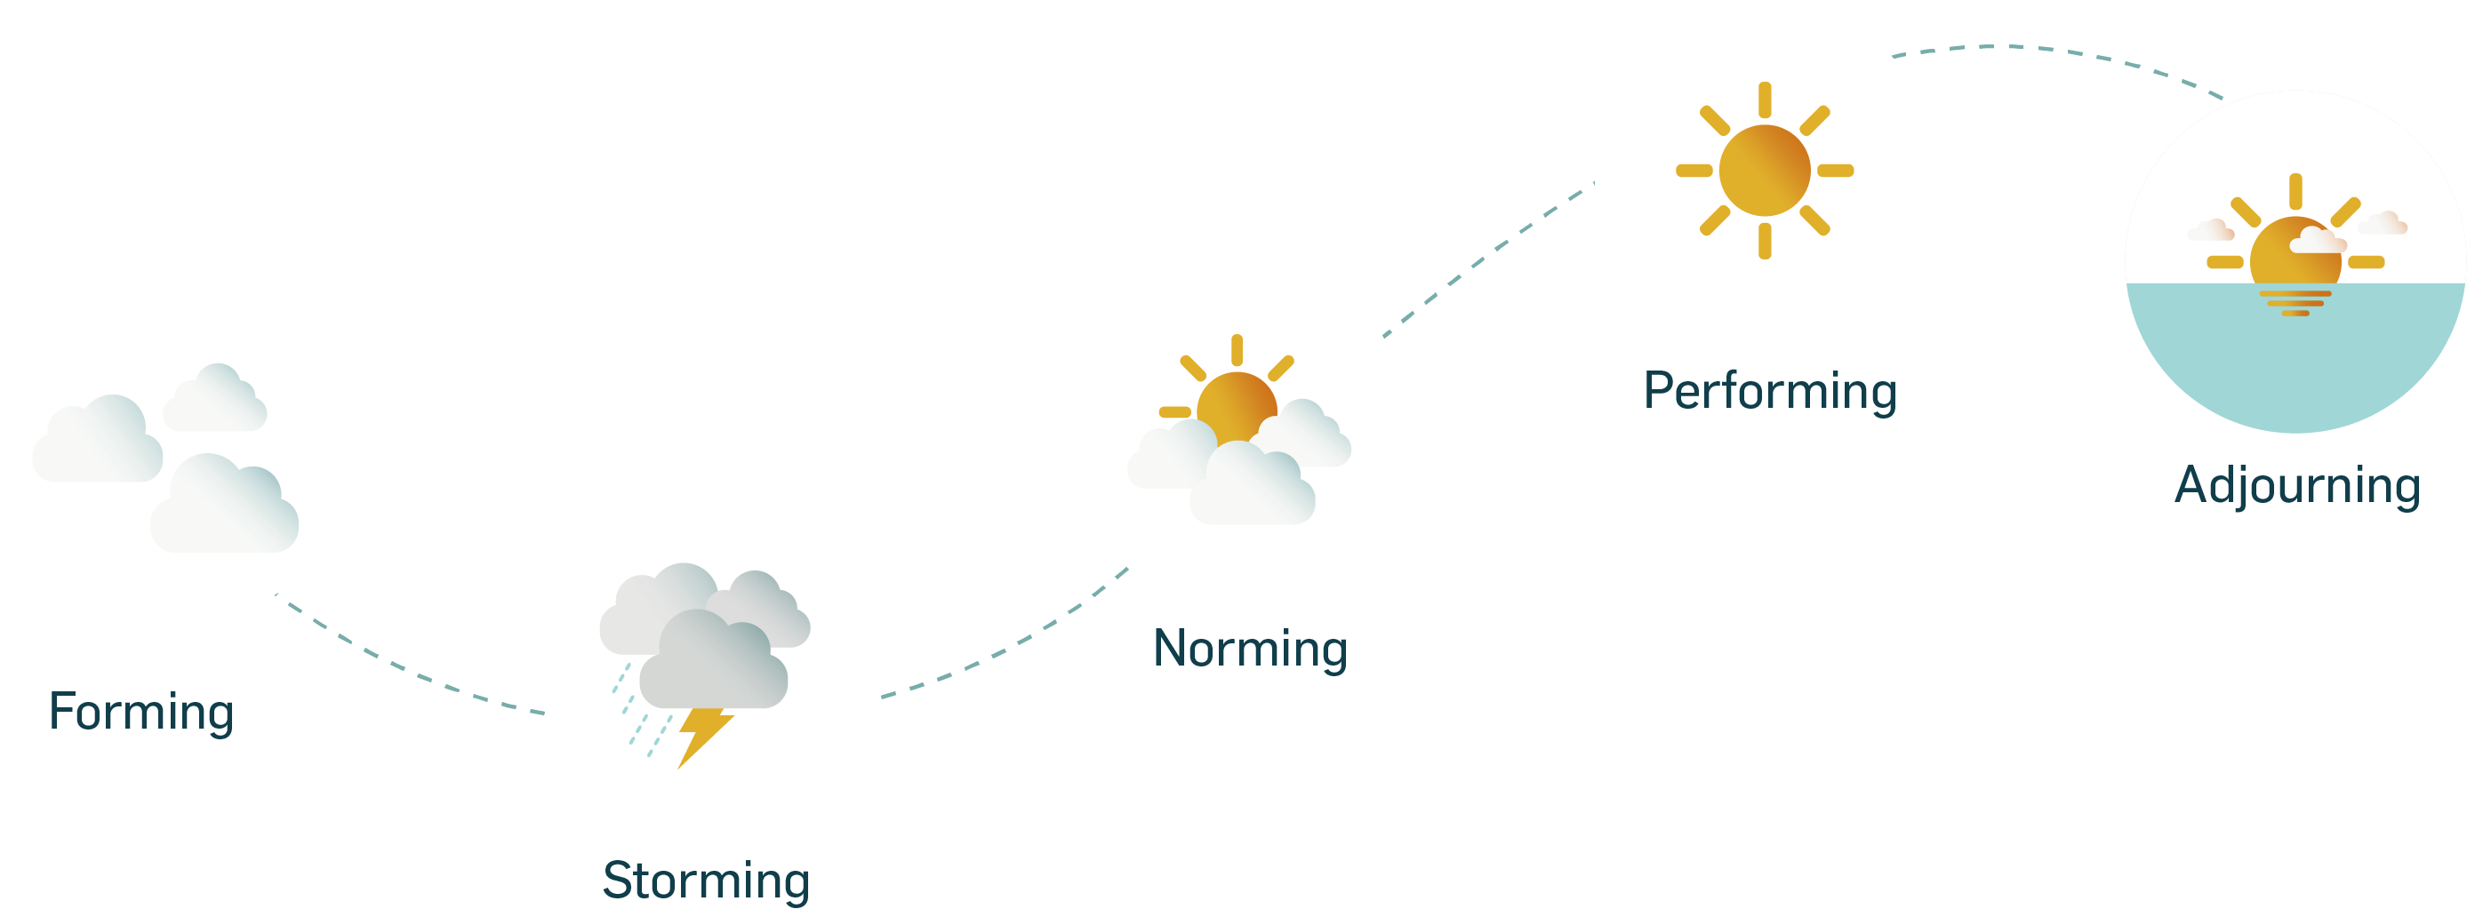
TEAM DEVELOPMENT PHASES

Slide 52

5 DYSFUNCTIONS

